Slide 1
Project With Purpose Divine World Multi-purpose Ecommerce
Presented By :
Dipesh Paudel(1900149)

Slide 2
INTRODUCTION
Multi-purpose Ecommerce helps us to take daily used products, books and courses on technical topics.
In my project we will use HTML, CSS, Bootstrap and Javascript as Front End. And I used Python Django, SQLite Database Connectivity as Back End.

Slide 3

TOOLS TO BE USED FOR DEVELOPMENT
VS Code:
VS Code provides an editor for PHP, HTML,CSS and JavaScript with on-the-fly code analysis, error prevention and automated refactoring for PHP and JavaScript code.

Slide 4
2. Django:
Python Django is a popular, free and open-source web framework used for building web applications. It is written in Python and follows the model-template-view architectural pattern. It has a built-in administration interface, ORM support, and a large and active community. Django also provides a lot of built-in functionality to handle common web development tasks such as user
13
authentication, URL routing, and database model management. It is used by many large companies such as Instagram and Pinterest.

Slide 5
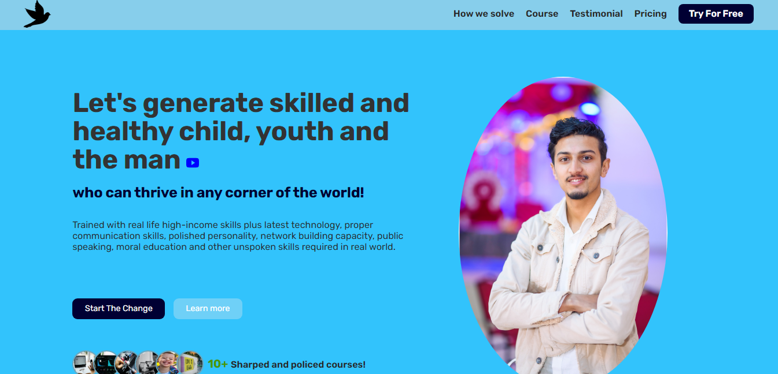
HOME PAGE

Slide 6
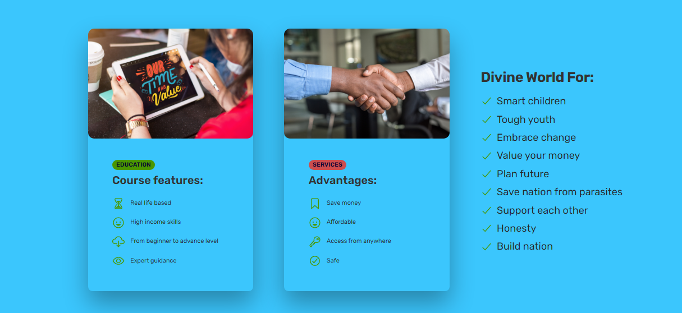

Slide 7
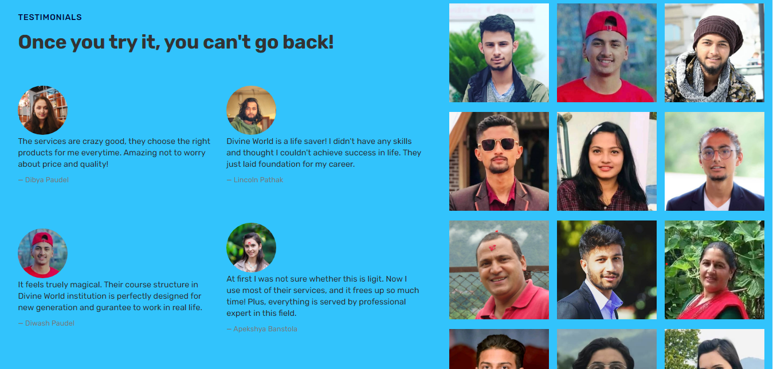

Slide 8
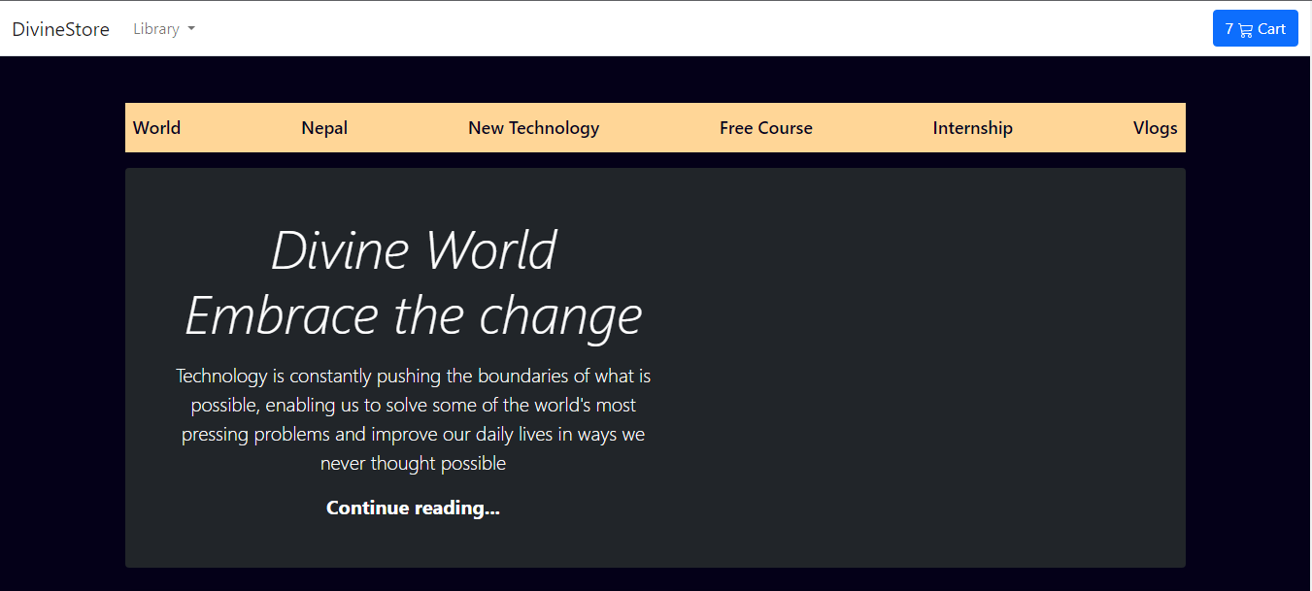

Slide 9
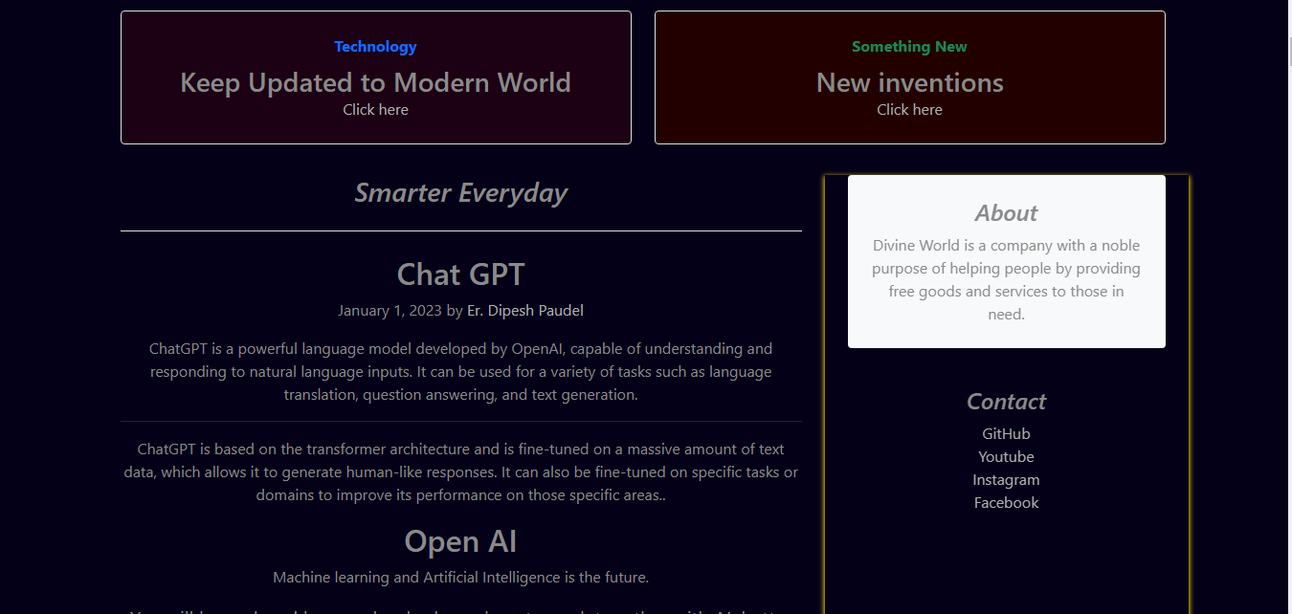

Slide 10
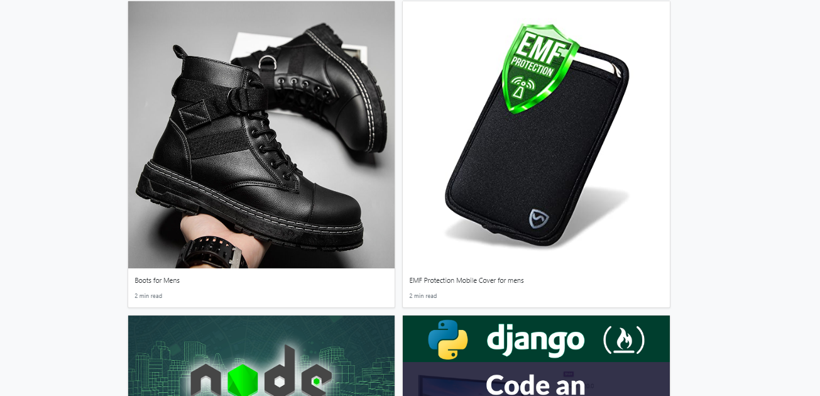

Slide 11
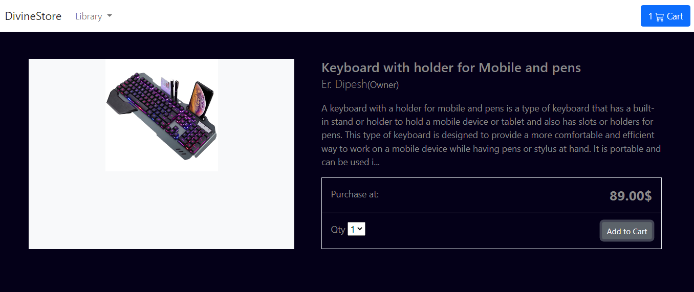
Admin Login

Slide 12
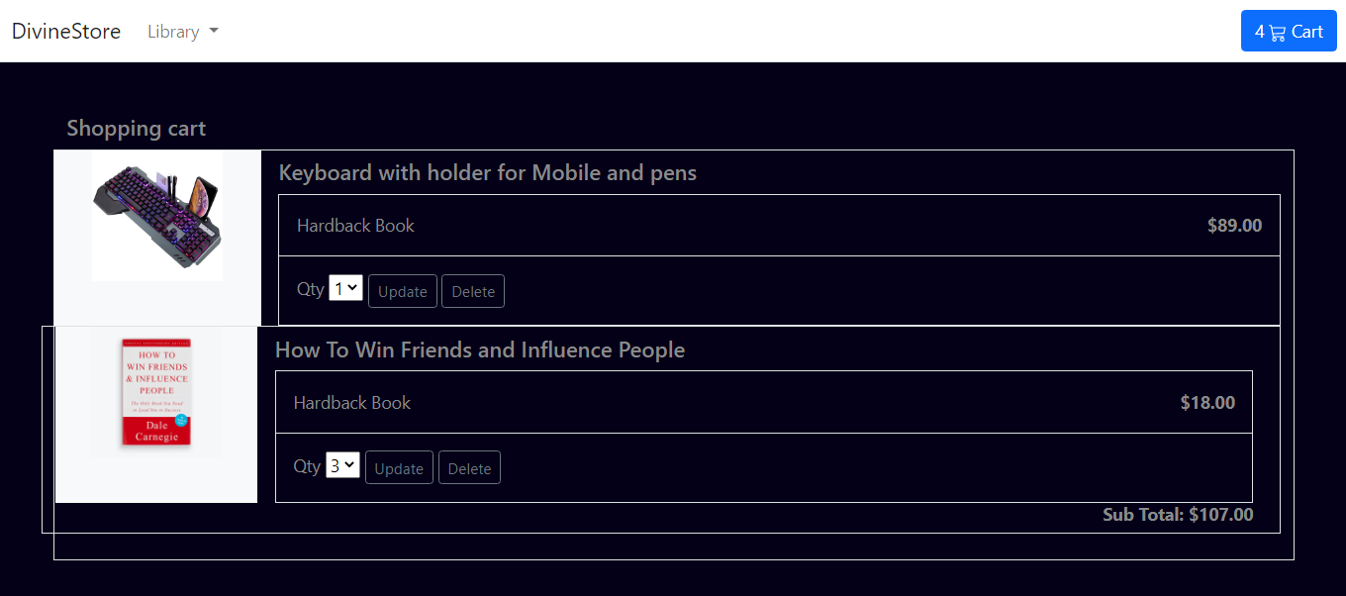
Admin Dashboard

Slide 13
THANK YOU

